Slide 1
Lecture 5: Random Walks & Plotting (download slides and .py files from Stellar to follow along)
John Guttag
MIT Department of Electrical Engineering and Computer Science

Slide 2
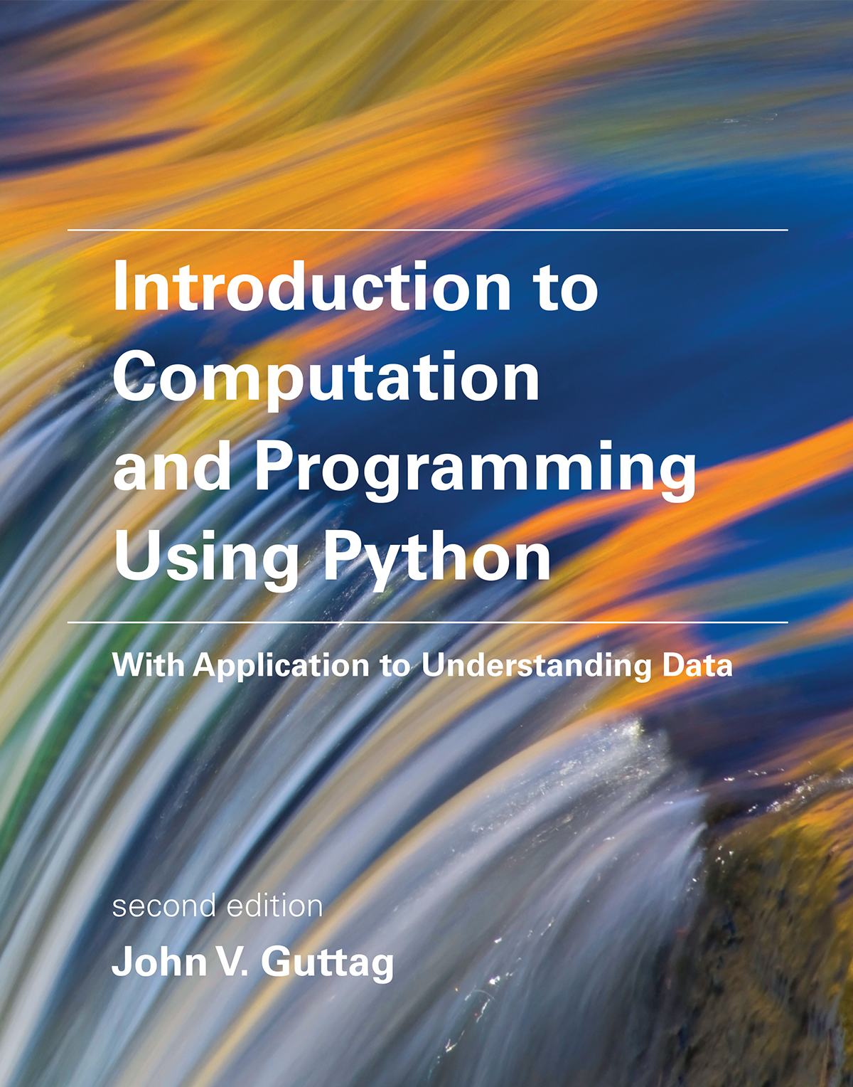
Relevant Reading
Today
Chapter 11
Chapter 14
Wednesday
Chapter 16

Slide 3
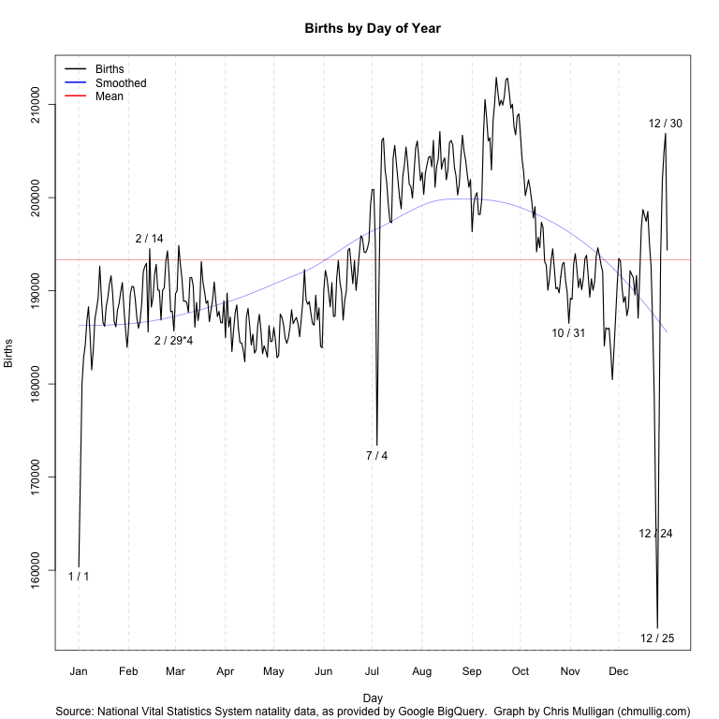
When We Last Met …
Looking at “birthday problem”
Analytical solution easy for numShared = 2
Analytical solution complicated for numShared > 2
Simulation easy
Analytical solution easy for uniform distribution of dates
Analytical solution not available for actual distribution of dates
Simulation easy, but results surprising

Slide 4
Summary of Stochastic Modeling
Can simulate stochastic process by:
defining an event (e.g., rolling a die N times, flipping a coin N times, randomly picking birthdays for N people),
then running some number of trials, and
estimating probability of observing particular event (e.g., rolling 11111, flipping HHHHH, finding two people with shared birthday)
In simple cases, can define mathematical formulas for likelihood of event
But in more complex cases, simulation is probably the better choice

Slide 5
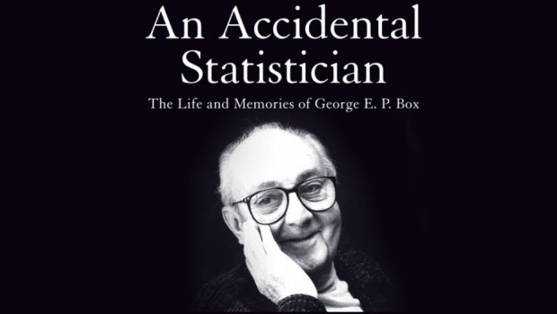
Simulation Models
A description of computations that provide useful information about the possible behaviors of the system being modeled
Descriptive, not prescriptive
Only an approximation to reality
“All models are wrong, but some are useful.” – George Box

Slide 6
Simulations Are Used a Lot
To model systems that are mathematically intractable
To extract useful intermediate results
To support iterative development by successive refinement and “what if” questions
We will start by simulating random walks

Slide 7
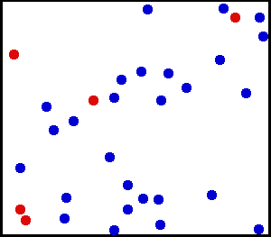
Why Random Walks?
Some systems are too complex to study directly or analyze mathematically
Random walks are important in many domains
Understanding the stock market, modeling diffusion processes, modeling cell movement, and many other examples
Good illustration of how to use simulations to understand things
Excuse to cover some important programming topics
Practice with classes
Practice with plotting

Slide 8
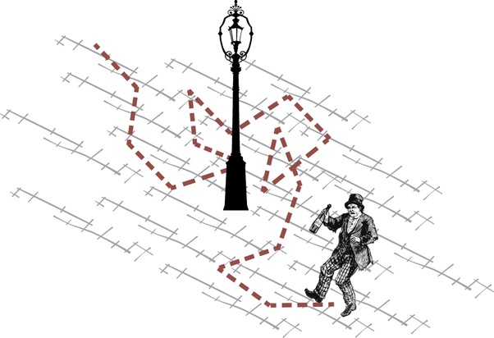


Drunkard’s Walk
How does distance from origin relate to number of steps?

Slide 9
One Possible First Step

Slide 10
Another Possible First Step

Slide 11
Yet Another Possible First Step

Slide 12
Last Possible First Step

Slide 13
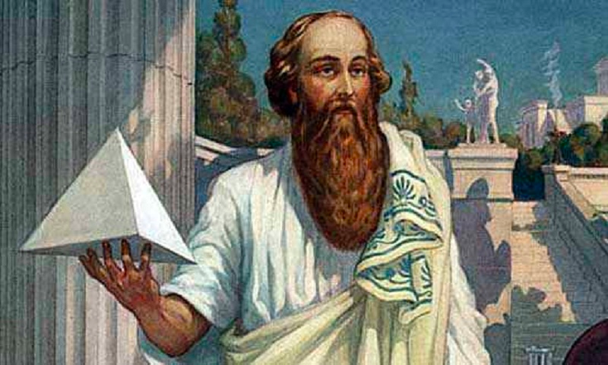
Possible Distances After Two Steps (assuming moved right on first step, other options similar)
1.41
0
2
1.41
Notes:
Draw in 0, 2, sqrt(2) = 1.41.4
Average = 1.21

Slide 14
Possible Distances After Two Steps
X 2
X 2
X 4
X 2
X 2
Average if equally likely is:
(2 + 2* 1.41 + 2 + 2* 1.41 + 2 + 2* 1.41 + 2 + 2 *1.4 + 0*4)/16
= 1.205

Slide 15
Expected Distance After 100,000 Steps?
Can see that expected distance seems to increase with number of steps, and certainly maximum distance does
Went from 0 to 1 to 1.205 as expected distance
But can we accurately model the actual expected distance?
Need a different approach to problem
Will use simulation

Slide 16
Structure of Simulation
Simulate one walk of k steps
Simulate n such walks, each of k steps
Report average distance from origin over set of n walks

Slide 17
First, Some Useful Abstractions
Location—a place
Field—a collection of places and drunks
Drunk—somebody who wanders from place to place in a field

Slide 18
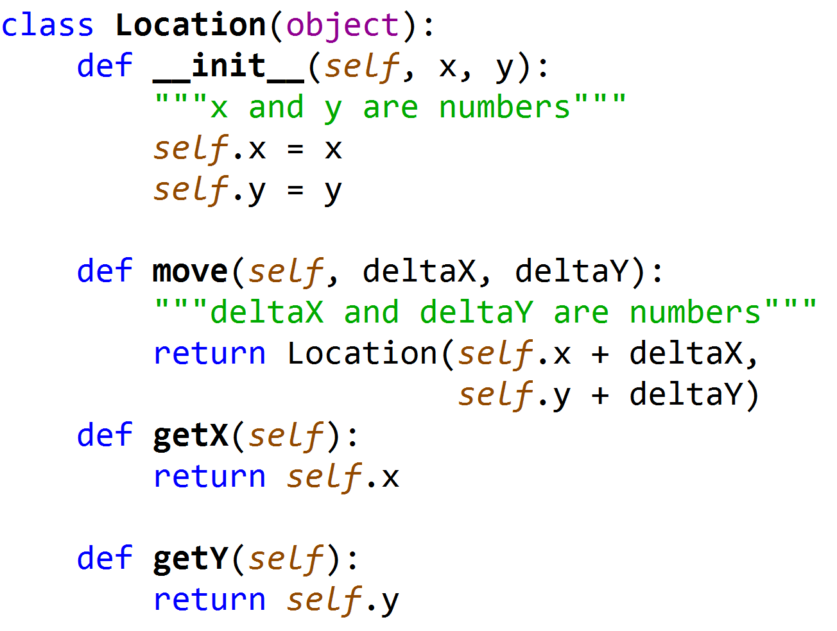
Class Location, part 1
Will let x, y, deltaX and deltaY be floats
More general than example

Slide 19
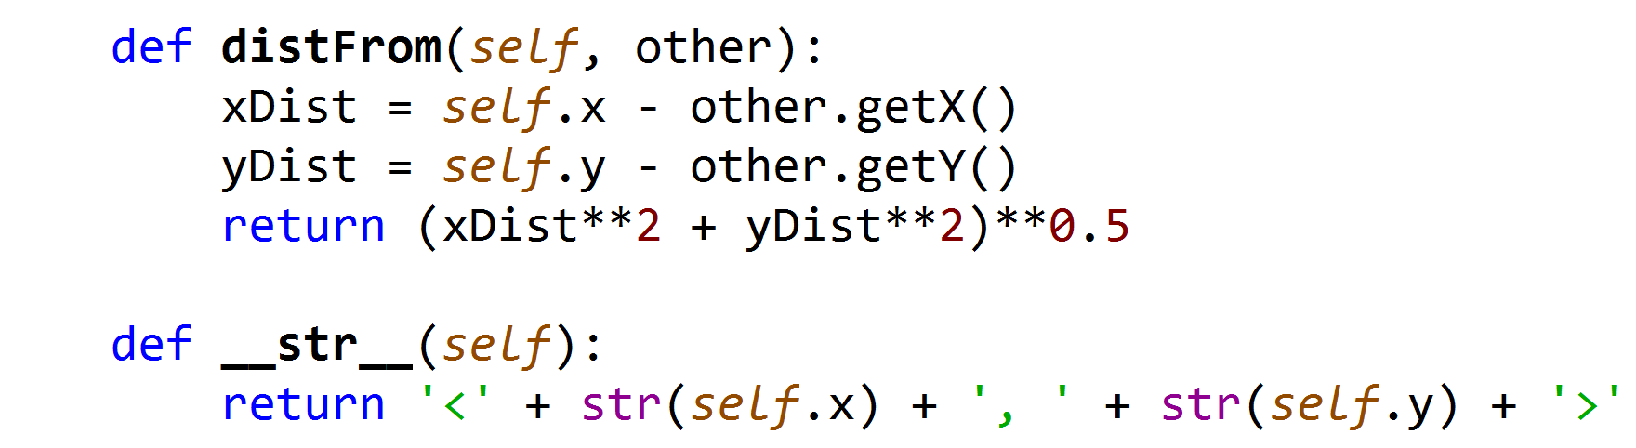
Class Location, continued

Slide 20
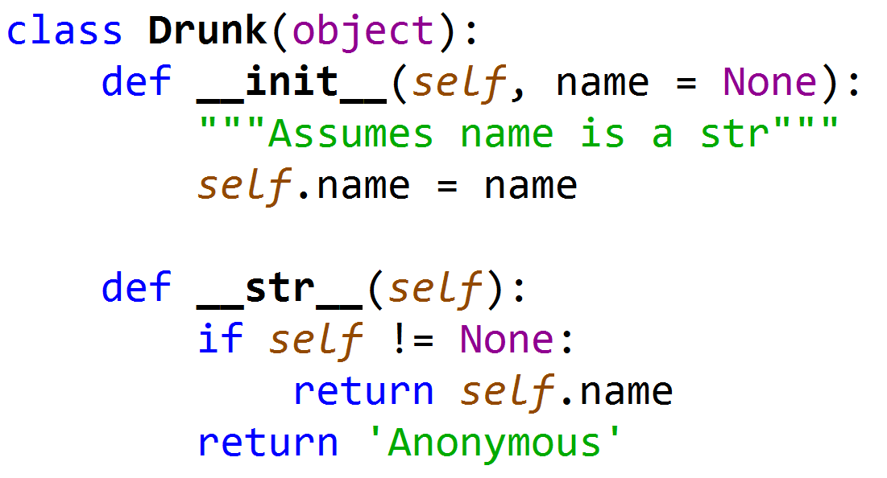
Class Drunk
Not intended to be useful on its own
A base class to be inherited

Slide 21

Two Subclasses of Drunk
The “usual” drunk, who wanders around at random
The “masochistic” drunk, who tries to move northward

Slide 22
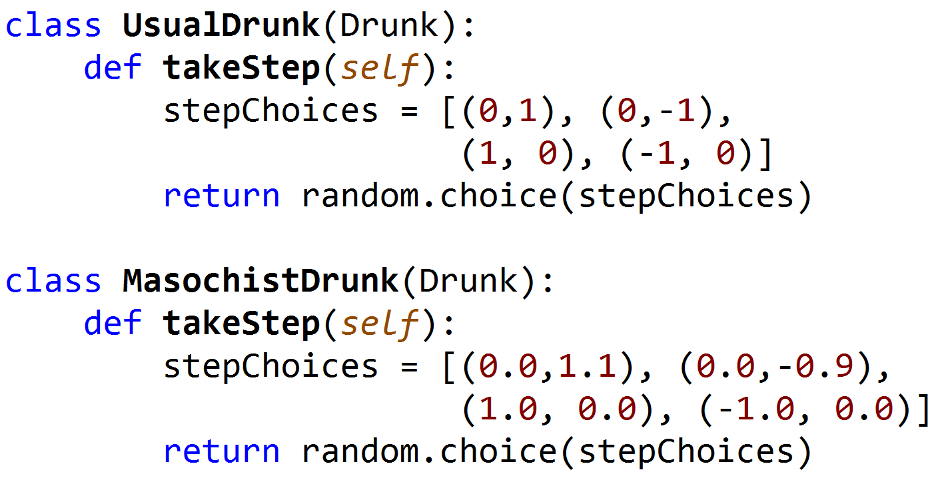
Two Kinds of Drunks
Taking a random step in cardinal directions with equal probability
Taking a random step, but slightly more likely to go north

Slide 23
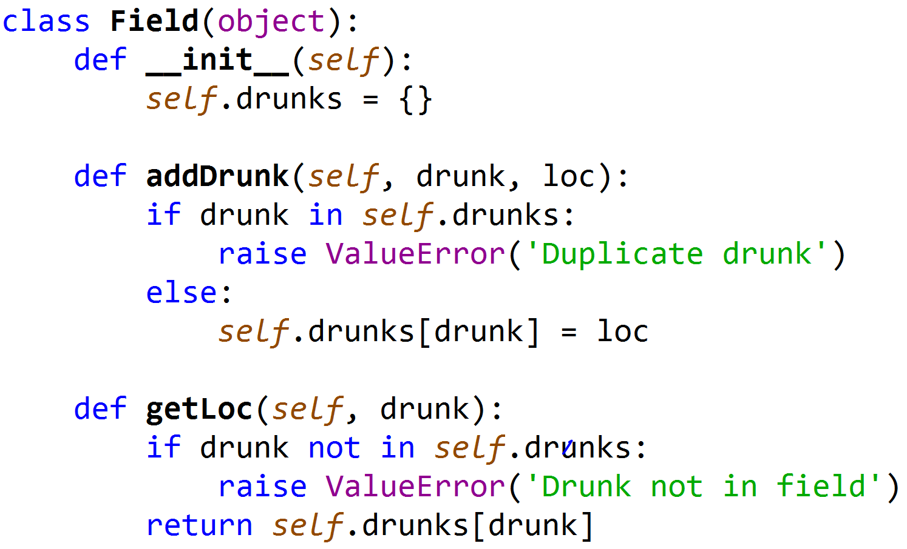
Class Field, part 1
Dictionary mapping Drunk to Location;
Can have many drunks in a field

Slide 24
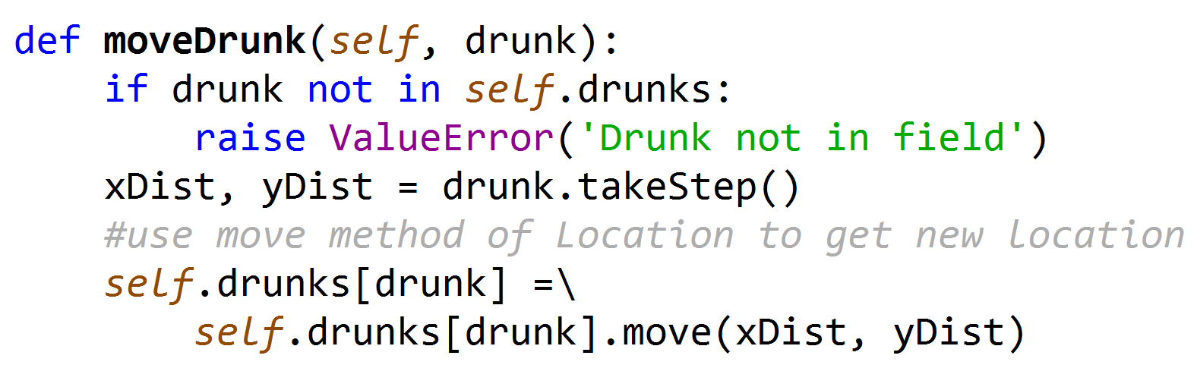
Class Field, continued
In which direction does the drunk move?
Dealing with Location object, so call method to set new location
Remember that move returns a new location by adding deltas to current location

Slide 25
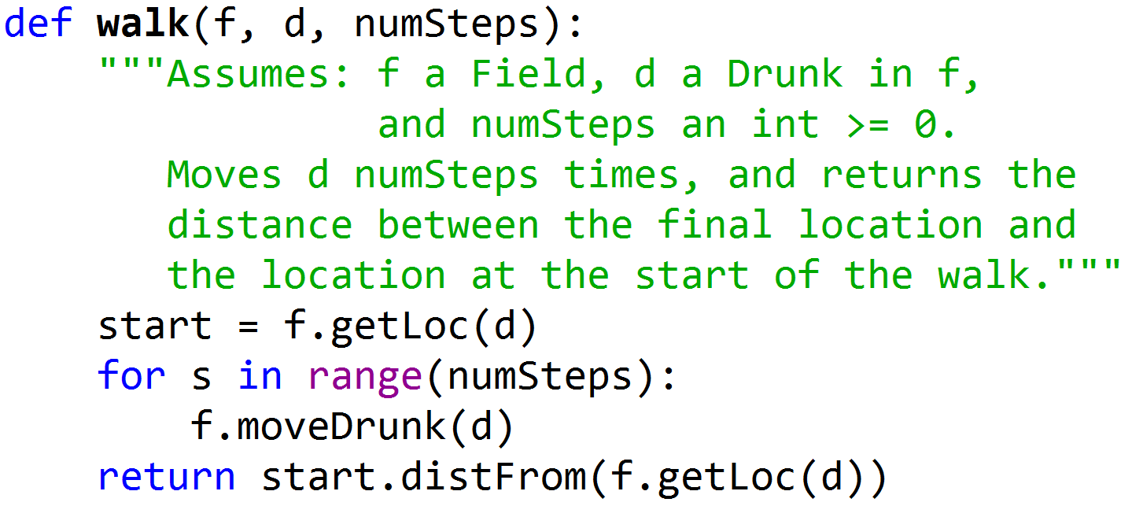
Simulating a Single Walk
Move drunk n numSteps steps in field f
Use method on location of drunk d to get distance from start object

Slide 26
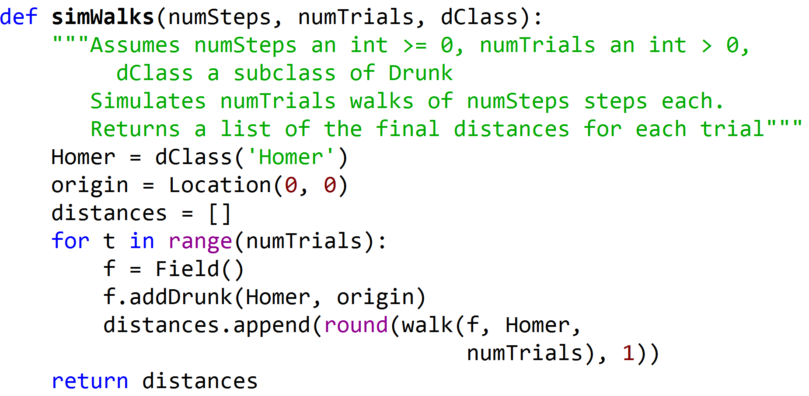
Simulating Multiple Walks
The name of a Python class, not an instance, leads to a generalized function.
Saw this with graphs.

Slide 27
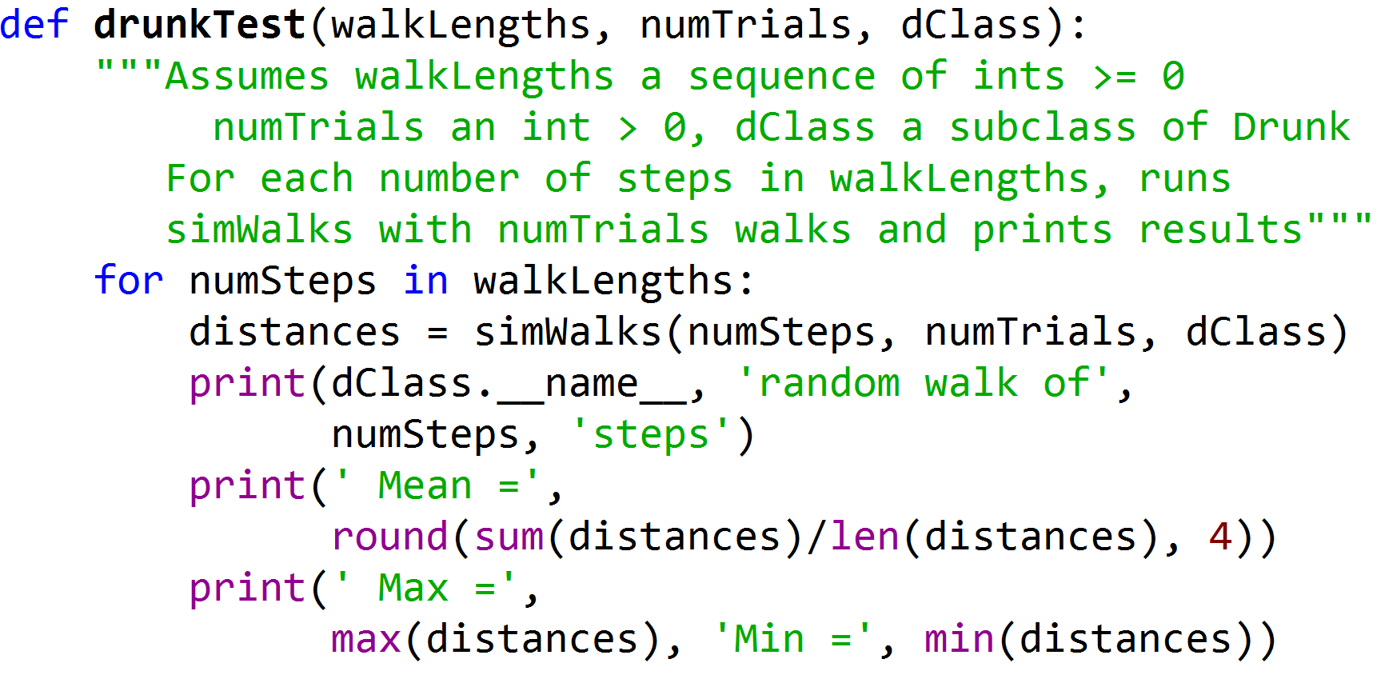
Putting It All Together

Slide 28
Let’s Try It
drunkTest((10, 100, 1000, 10000), 100,
UsualDrunk)
UsualDrunk random walk of 10 steps
Mean = 8.634
Max = 21.6 Min = 1.4
UsualDrunk random walk of 100 steps
Mean = 8.57
Max = 22.0 Min = 0.0
UsualDrunk random walk of 1000 steps
Mean = 9.206
Max = 21.6 Min = 1.4
UsualDrunk random walk of 10000 steps
Mean = 8.727
Max = 23.5 Min = 1.4
Plausible?
Notes:
Draw frowning face

Slide 29
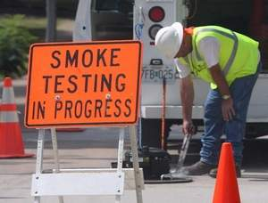
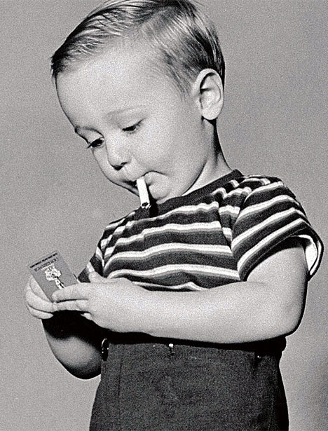

Let’s Try a Smoke Test
Try on cases where we think we know the answer
A very important precaution!

Slide 30


Sanity Check
drunkTest((0, 1, 2) 100, UsualDrunk)
UsualDrunk random walk of 0 steps
Mean = 8.634
Max = 21.6 Min = 1.4
UsualDrunk random walk of 1 steps
Mean = 8.57
Max = 22.0 Min = 0.0
UsualDrunk random walk of 2 steps
Mean = 9.206
Max = 21.6 Min = 1.4
distances.append(round(walk(f, Homer,
numTrials), 1))
# in simWalks
numSteps

Slide 31
Simulating Multiple Walks
numSteps

Slide 32
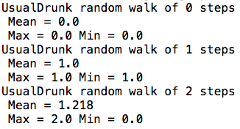

Trying the Smoke Test Again

Slide 33
Trying the Original Test Again
drunkTest((10, 100, 1000, 10000), 100,
UsualDrunk)
UsualDrunk random walk of 10 steps
Mean = 2.863
Max = 7.2 Min = 0.0
UsualDrunk random walk of 100 steps
Mean = 8.296
Max = 21.6 Min = 1.4
UsualDrunk random walk of 1000 steps
Mean = 27.297
Max = 66.3 Min = 4.2
UsualDrunk random walk of 10000 steps
Mean = 89.241
Max = 226.5 Min = 10.0
Notes:
Draw frowning face

Slide 34
And the Masochistic Drunk?
random.seed(0)
simAll((UsualDrunk, MasochistDrunk),
(1000, 10000), 100)
UsualDrunk random walk of 1000 steps
Mean = 26.828
Max = 66.3 Min = 4.2
UsualDrunk random walk of 10000 steps
Mean = 90.073
Max = 210.6 Min = 7.2
MasochistDrunk random walk of 1000 steps
Mean = 58.425
Max = 133.3 Min = 6.7
MasochistDrunk random walk of 10000 steps
Mean = 515.575
Max = 694.6 Min = 377.7

Slide 35
Visualizing the Trend
Simulate walks of multiple lengths for each kind of drunk
Plot distance at end of each length walk for each kind of drunk

Slide 36
PLOTTING

Slide 37
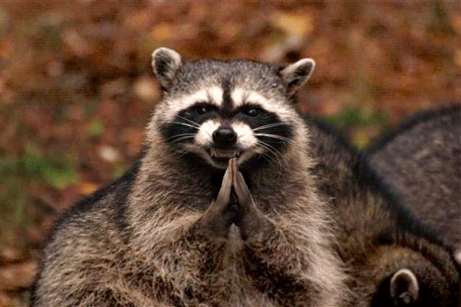
WHY PLOTTING?
Sooner or later, everyone needs to produce plots
As we look at data in 6.0002 half of term, we will make extensive use of plots to visualize results
Example of leveraging an existing library, rather than writing procedures from scratch
See problem sets
Python provides libraries for (among other topics):
Stochastic computation
Plotting
Numerical computation
Seen a bit of this
Very similar to Matlab
Still to come in 6.0002

Slide 38
PYLAB
Can import library into computing environment
import mataplotlib.pyplot as plt
Allows code to reference library procedures as plt.<procName>
Provides access to existing set of graphing/plotting procedures
Here will just show some simple examples; lots of additional information available in documentation associated with matplotlib
Will see many other examples and details of these ideas in rest of term

Slide 39
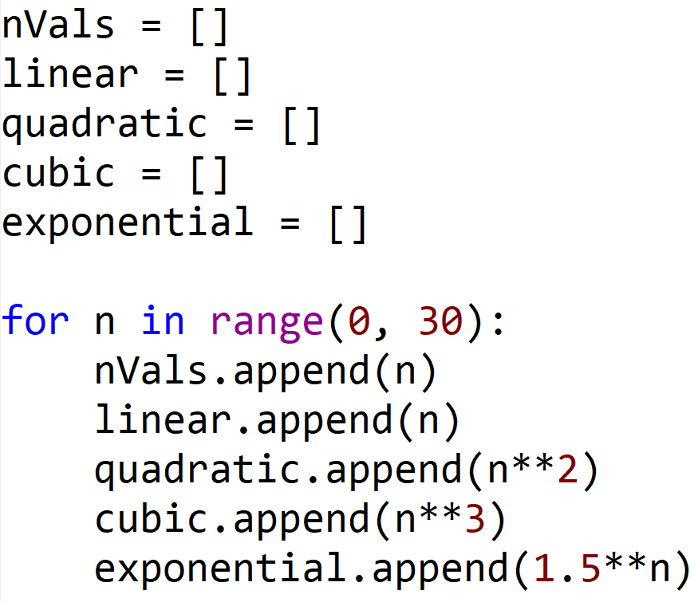
A SIMPLE EXAMPLE
Used 1.5 to keep displays visible, more common value for order of growth example would be 2

Slide 40
PLOTTING THE DATA
X values
Y values
To generate a plot:
plt.plot(n, <function of n>)
Arguments are lists of numbers (for now)
lists must be of the same length
Generates a sequence of <x, y> values
Plotted in order, then connected with lines
Calling function in an iPython console will generate plots within that console
Calling function in a Python console will create a separate window in which plot is displayed

Slide 41
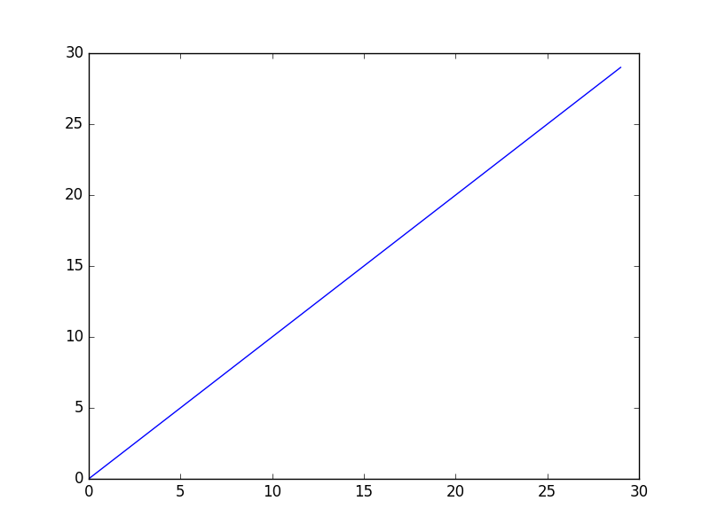
EXAMPLE

Slide 42
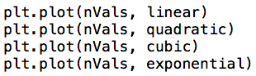
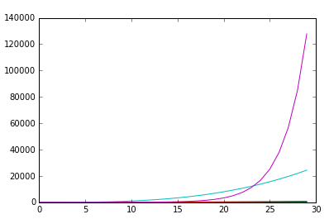
SHOWING ALL DATA ON ONE PLOT
Impossible to see linear graph, or even quadratic graph
Problem is that scale is so different

Slide 43
PRODUCING MULTIPLE PLOTS
gives a name to this figure; allows us to reference for future use
Let’s graph each one separately
Call
plt.figure(<arg>)
Creates a new display with that name if one does not already exist
If a display with that name exists, reopens it for processing

Slide 44
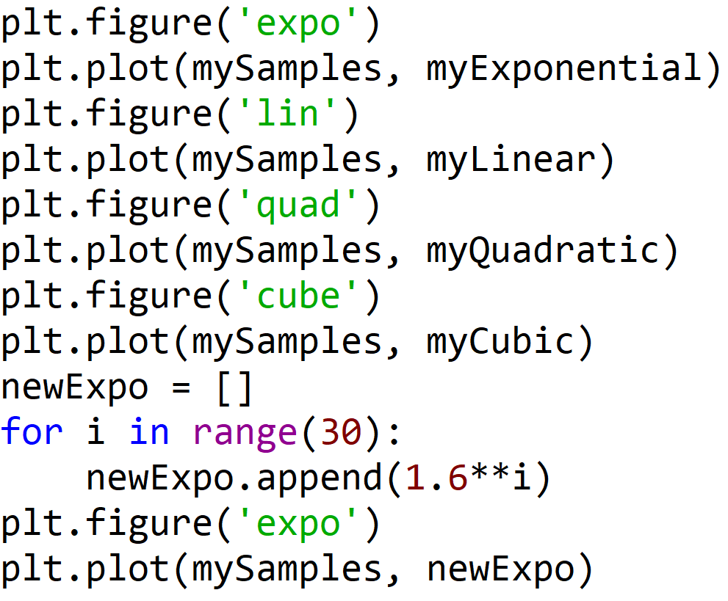
EXAMPLE CODE
Go back to expo

Slide 45
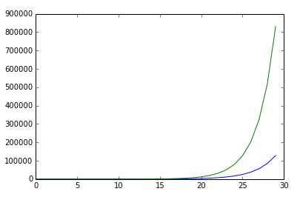
PLOT WITH EXPONENTIALS
Second curve
First curve

Slide 46

Five Minute Break

Slide 47
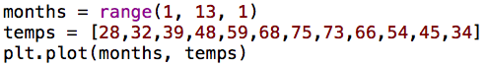
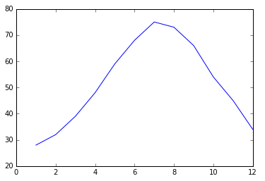
A “REAL” EXAMPLE
But what is this trying to tell us?

Slide 48
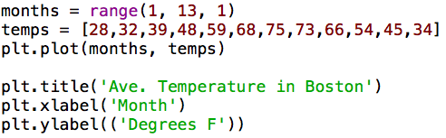
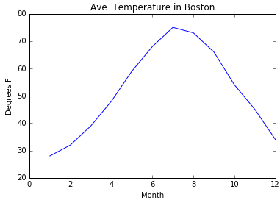
A “REAL” EXAMPLE
Still a bit weird looking

Slide 49
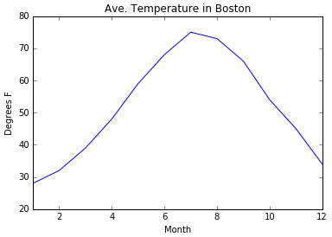
A “REAL” EXAMPLE
Suppose I want to see each month on x-axis?

Slide 50
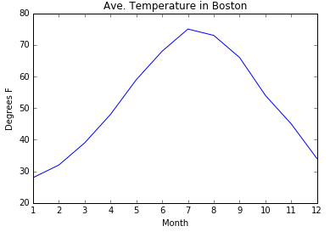
A “REAL” EXAMPLE
But what about those who can’t map numbers to months?

Slide 51
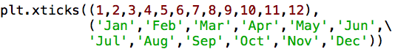
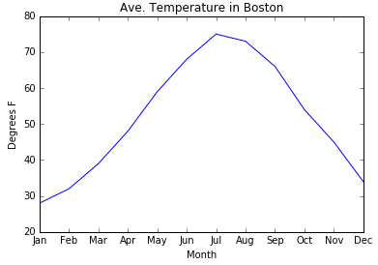
A “REAL” EXAMPLE

Slide 52
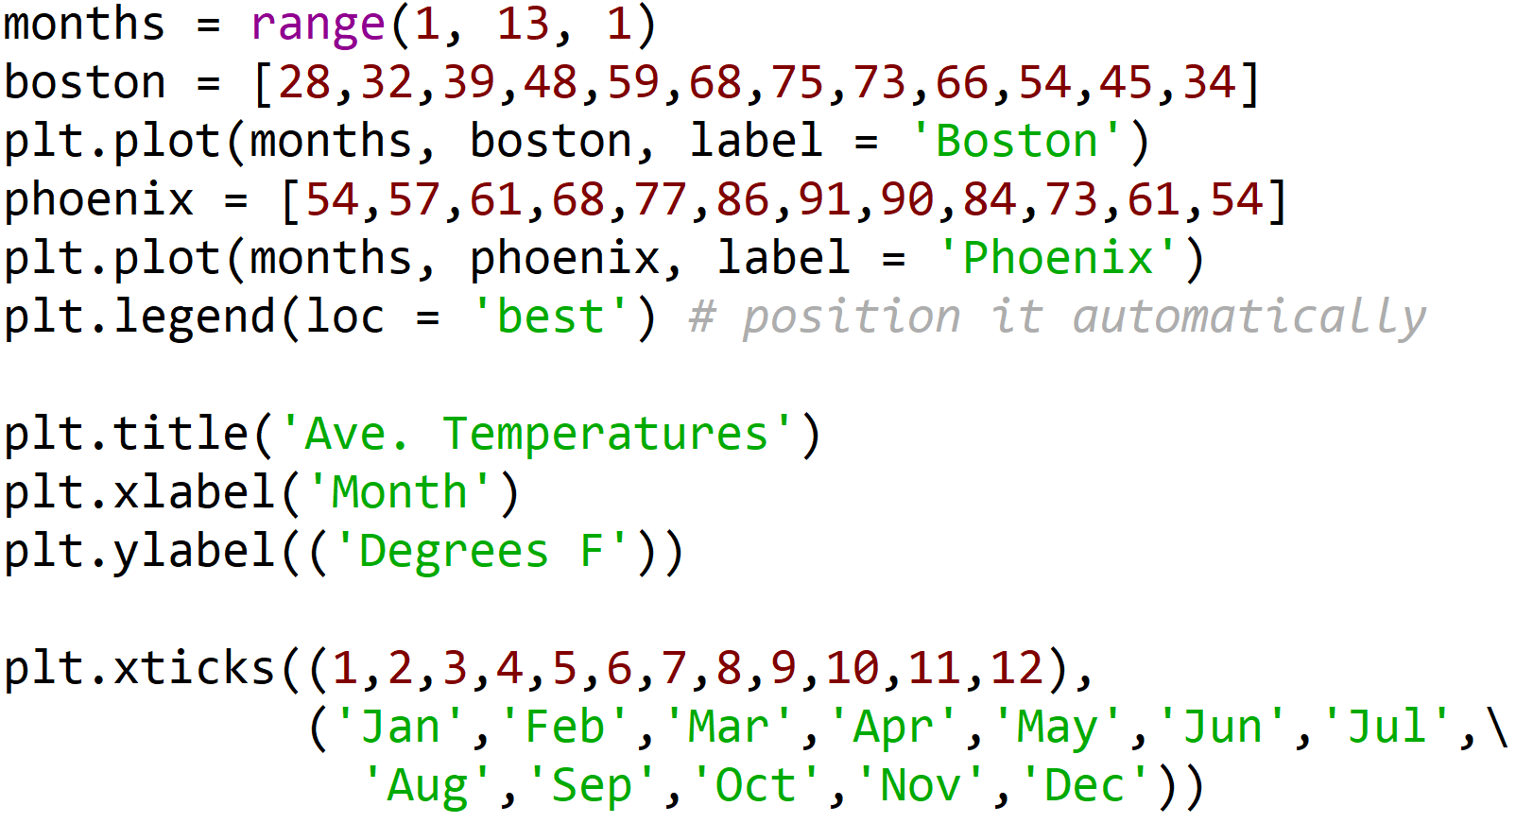
LET’S ADD ANOTHER CITY

Slide 53
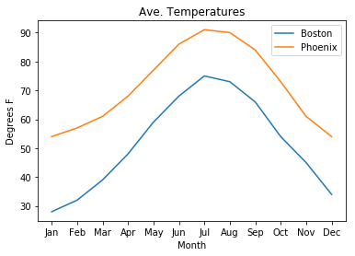
Plot with Two Cities

Slide 54
Controlling Display Parameters
Suppose we want to control details of the displays themselves
Examples:
Changing color or style of data sets
Changing width of lines or displays
Using subplots

Slide 55
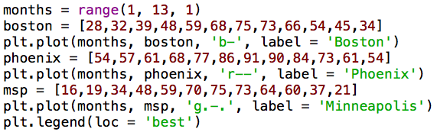
CONTROLLING COLOR AND STYLE

Slide 56
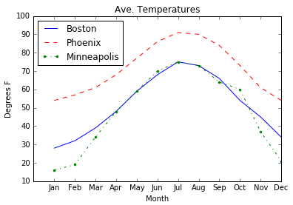
CONTROLLING COLOR AND STYLE

Slide 57
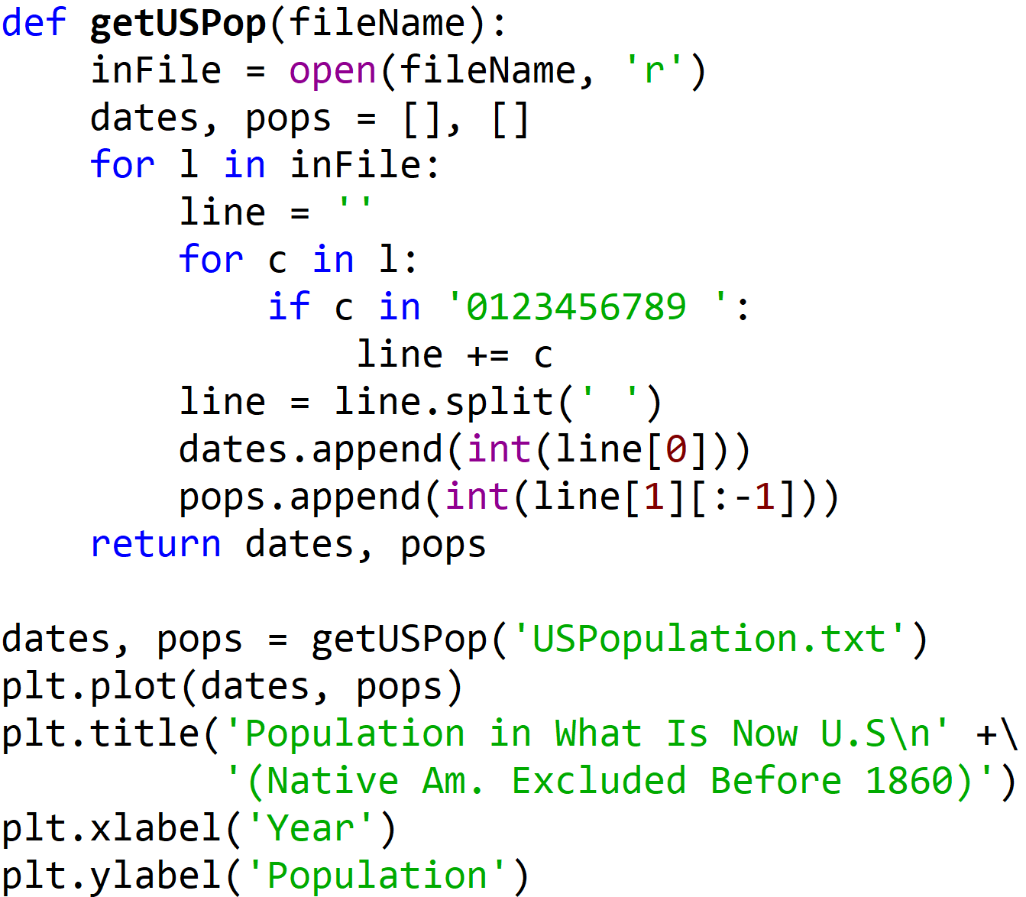
CONTROLLING SCALE
USPopulation.txt
1610 350
1620 2,302
1630 4,646
1640 26,634
1650 50,368
1660 75,058
1670 111,935
.
.
.
2010 308,745,538

Slide 58
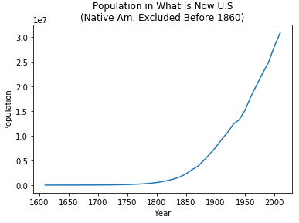
POPULATION GROWTH
Because population small, looks like growth is flat on linear scale
What’s going on in the early years?
Notes:
Because populations was relatively small in early years, it looks like it flat on a linear scale.

Slide 59
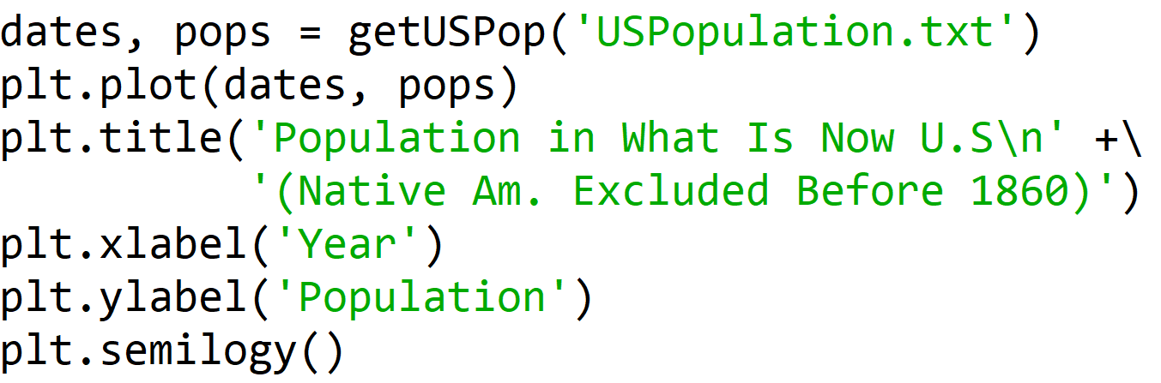
CHANGING THE SCALE

Slide 60
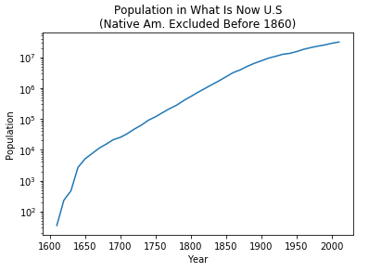
POPULATION GROWTH
What does linear growth on a log scale mean?
Exponential
In fact population growing quickly in early years; numbers very small in absolute sense
Notes:
Now we can see that on a relative basis, the population was growing quickly in the early years. On the other hand the numbers are very small in an absolute sense.
The apparently “linear growth” in the red box, is actually exponential growth because of the log scale on the y-axis.

Slide 61
Which Do You Find More Informative?
Probably depends upon what you are about
Notes:
No right answer to this question. Point is that same data can look very different depending upon how it is plotted.

Slide 62
BACK TO OUR WANDERING DRUNK

Slide 63
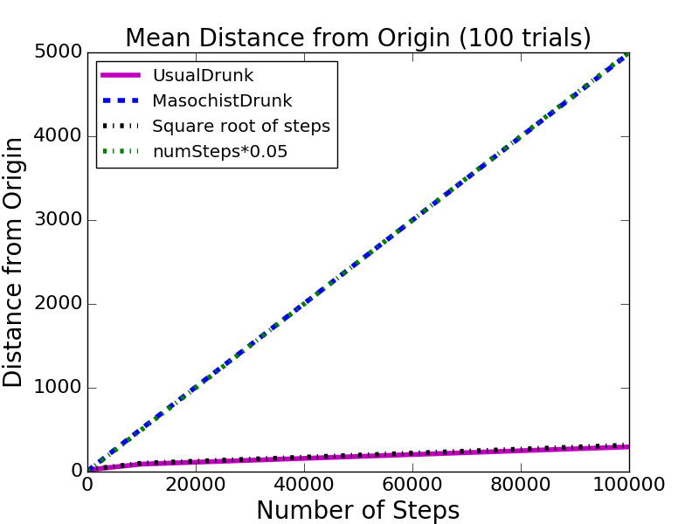
Distance Trends

Slide 64
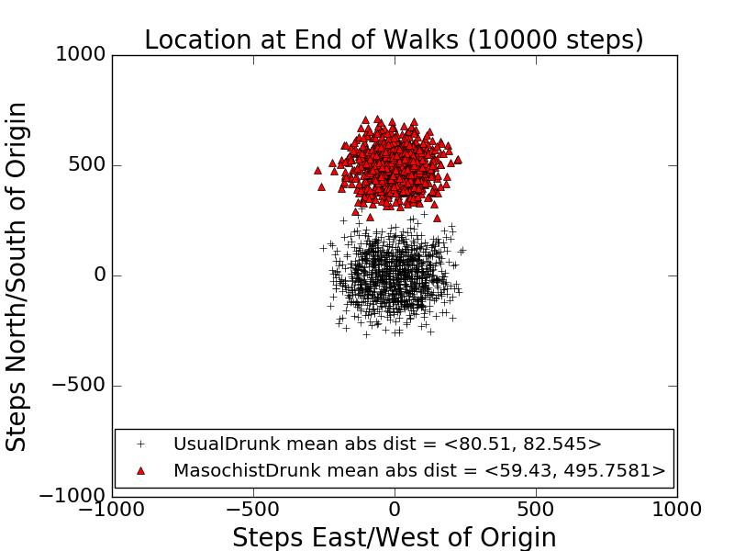
Ending Locations

Slide 65


Fields with Wormholes

Slide 66
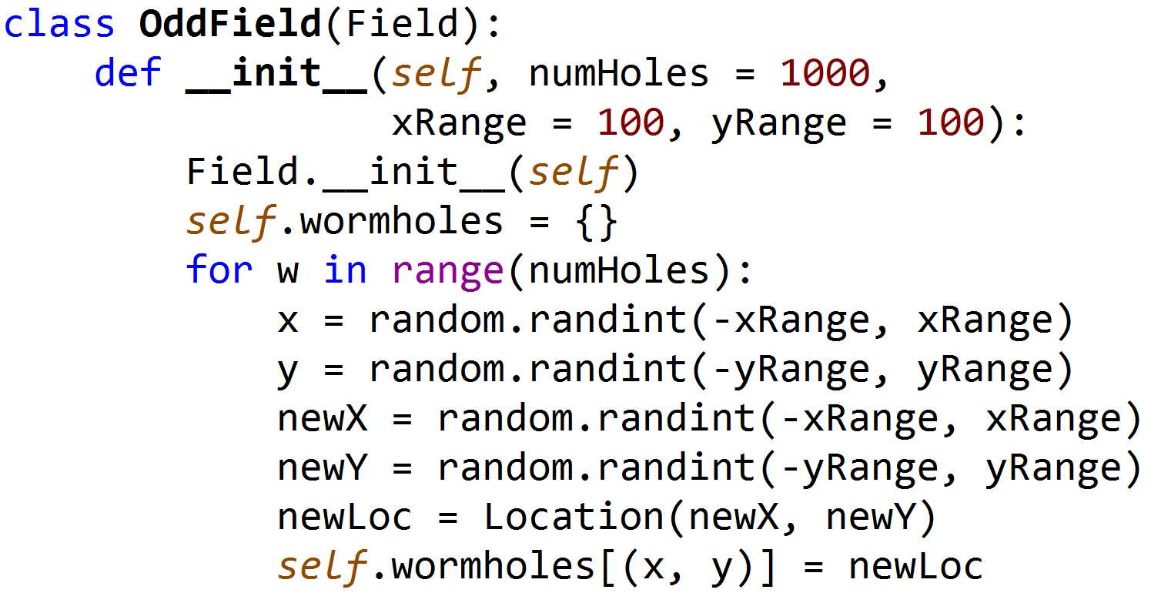
A Subclass of Field, part 1

Slide 67
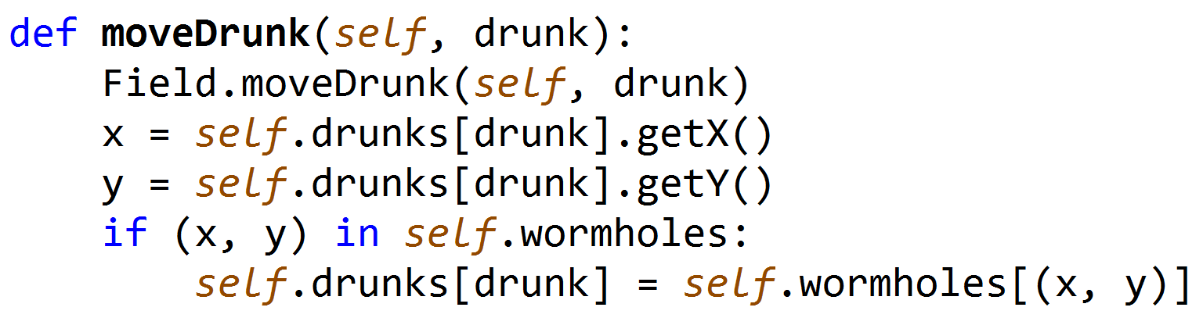
A Subclass of Field, part 2

Slide 68
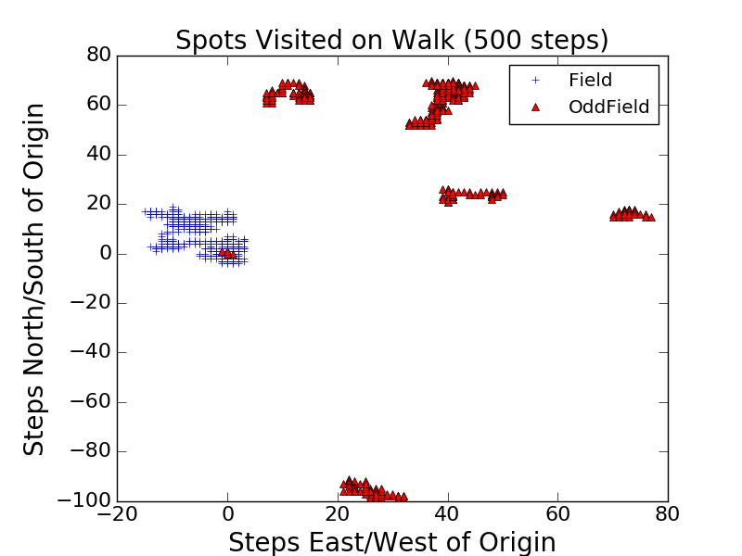
Spots Reached During One Walk

Slide 69
Summary
Point is not the simulations themselves, but how we built them
Started by defining classes
Built functions corresponding to
One trial, multiple trials, result reporting
Made series of incremental changes to simulation so that we could investigate different questions
Get simple version working first
Did a sanity check!
Enhanced simulation a step at a time
Showed how to use plots to get insights

